Slide 1
Colored Cone Detection Using YOLOv8
Presented by
Badr chaouch
Bhanu vignesh ganeshna
Notes:
"Good morning everyone. Today, my partner Badr and I will present our project on Autonomous Navigation: Colored Cone Detection using the YOLOv8 architecture. We will discuss how we built a robust vision system capable of high-precision detection despite significant environmental constraints."

Slide 2
PROBLEM STATEMENT & OBJECTIVE
GOAL | Detect & classify colored cones (Blue / Green / Orange)
CHALLENGE | Limited dataset (114 training images)
SOLUTION | Transfer learning with YOLOv8n (pretrained on COCO)
Notes:
"Our core objective was to detect and classify three specific navigation cones—Blue, Green, and Orange. The primary challenge we faced was the data constraint: we only had 114 training images. In deep learning, this is a very small number. To solve this, we used Transfer Learning with the YOLOv8-Nano model, leveraging weights pretrained on the COCO dataset to give our model a 'head start' in recognizing shapes and edges."

Slide 3
Dataset Overview
Dataset Creation
Dataset Variations
Total images | 152 images
Dataset Split | Train (114), val (22), and test (16)
Capture device | Smartphone
Environment | Indoor with varied backgrounds
Surfaces | Bags, Jacket, Laptop, Wood table, and also the floor
Poses | Front, side, angled, upside down
Framing | Full, hidden, partial
Lighting | Bright, dim, shadow, mixed
Distance | Close-up, medium, far
Notes:
"We captured a total of 152 images using a smartphone. Our environment was complex, featuring varied indoor backgrounds and challenging surfaces like jackets, laptops, and a speckled floor that often confuses AI models. To ensure the model was robust, we captured the cones in diverse poses—angled, upside down, and even partially hidden—at distances ranging from close-ups to four meters."

Slide 4
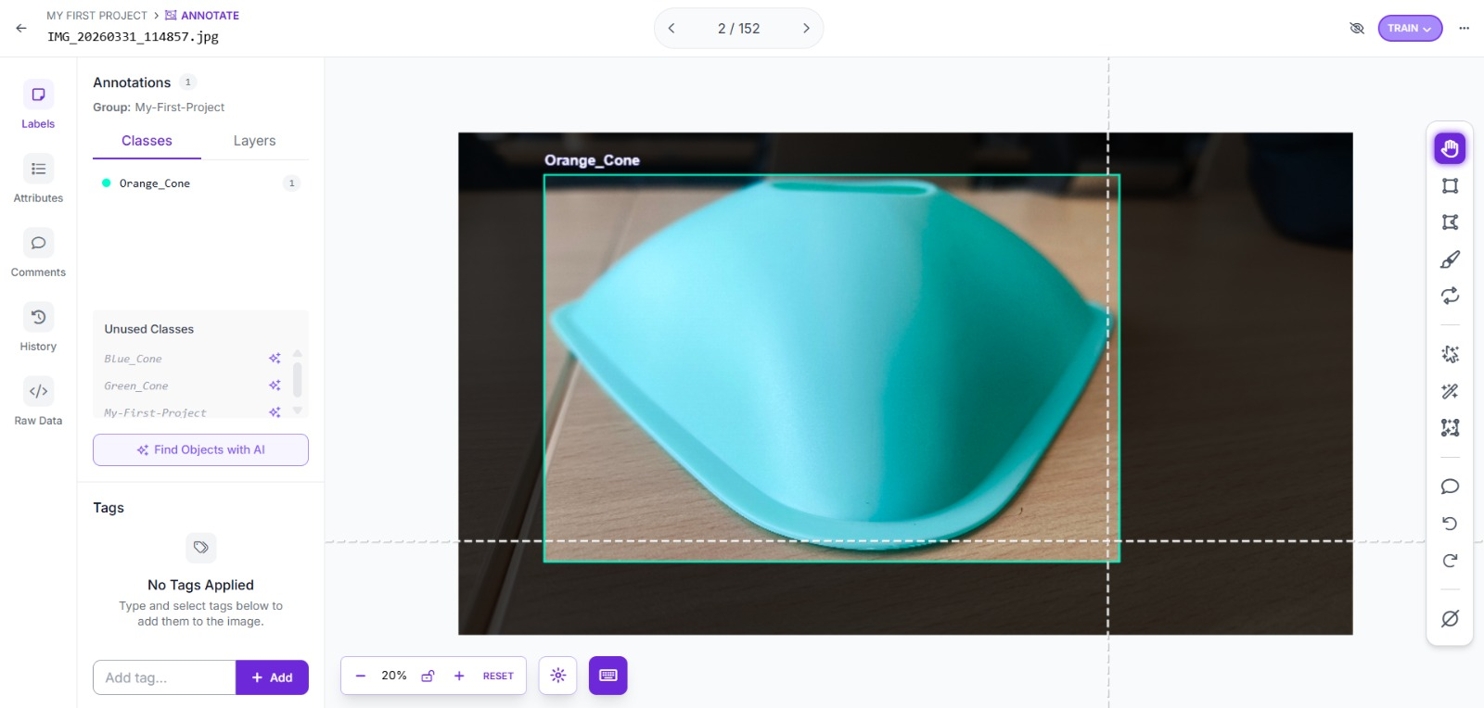
Data Annotations using Roboflow
Notes:
"For annotation, we used Roboflow to draw tight bounding boxes around each cone. Consistency was our priority here; we ensured that the labels were tight to the object boundaries to help the model learn the exact geometry of the cones, which is critical for the localization tasks we’ll see in our results."

Slide 5
Preprocessing & Augmentation
RESIZING | All images to 640×640pixels (YOLO input size)
NORMALIZATION | Pixel values scaled to [0, 1]
Preprocessing:-
Data Augmentation (Training only)
Augmentation | Value | Purpose
Rotation | 180° | Handle upside-down cones
Saturation | 90% | Handle lighting/color intensity
Hue shift | 2% | Handle off-center cones
Mosaic | 100% | Combine 4 images → better generalization
Scale | 60% | Handle different distances
... | ... | ...
Notes:
"This is the most critical part of our pipeline. Since our dataset was small, we used 'Torture Test' augmentations. We applied 180-degree rotations to handle upside-down cones and 100% Mosaic augmentation—which stitches four images into one—to force the model to find objects in cluttered scenes. We also used heavy Hue and Saturation shifts so the model would learn the shape of the cone rather than just a specific shade of color."

Slide 6
Training Setup
Parameter | Value
Optimizer | AdamW
Learning rate | 0.01
Patience | 30
Batch size | 8
Epochs | 150
Loss function | Box loss + Class loss + DFL (YOLO built-in)
Hardware | GPU : NVIDIA Ge-Force RTX 4050
Notes:
"We trained the model on an NVIDIA RTX 4050 Laptop GPU. We chose the AdamW optimizer with a learning rate of 0.01. We set the training for 150 epochs but included a 'patience' of 30, meaning if the model stopped improving for 30 rounds, the training would end to prevent overfitting. Our loss function was a combination of Box, Class, and DFL loss, ensuring the model got better at location, identification, and precision simultaneously."

Slide 7
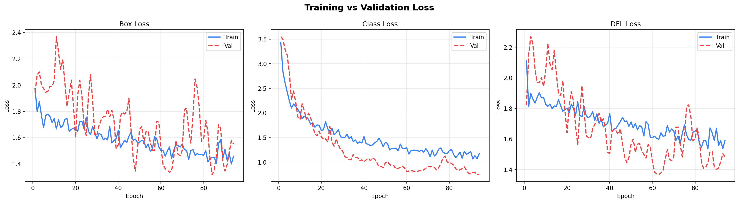
Training Results
Epoch | Validation Accuracy
10 | 70%
50 | 87%
100 | 90%
150 | 92.25%
Notes:
"Here we see our 'Evidence of Learning.' Our final validation accuracy reached 92.25%. Looking at the loss curves, you’ll notice the validation loss (in blue) tracks the training loss very closely. This is the 'Gold Standard' in training; it proves our model isn't just memorizing our photos, but is actually learning to generalize the features of the cones."

Slide 8
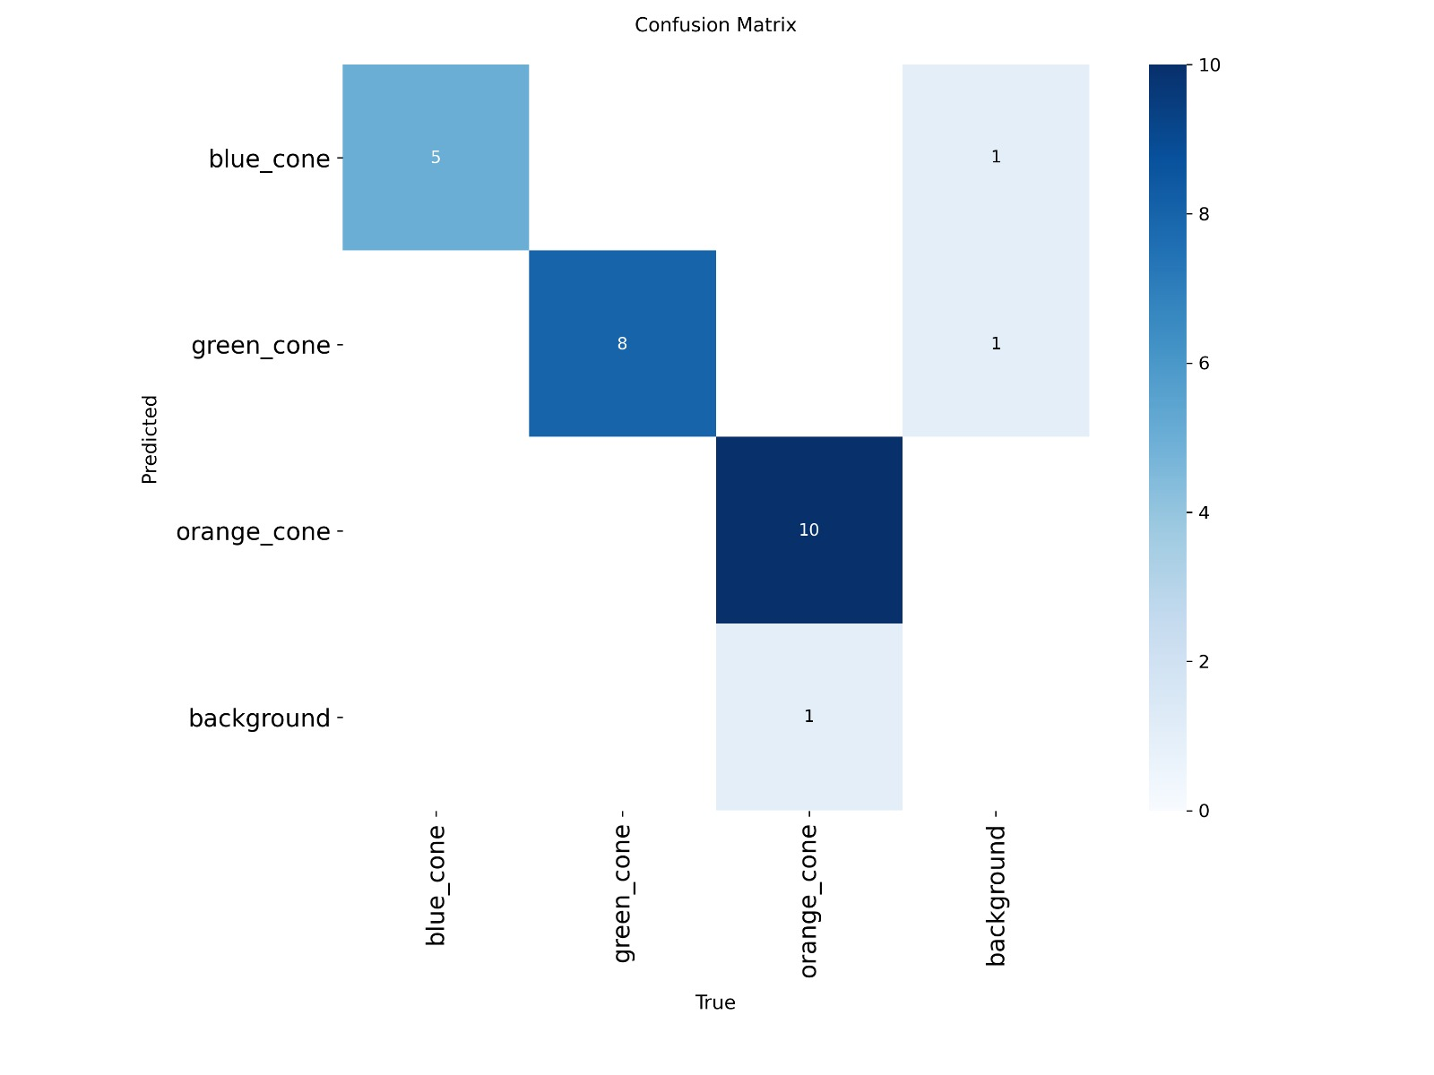
Test Results
Final Test Accuracy: 97.14%
Metric | Validation | Test
Precision | 96.84% | 97.14%
Recall | 92.08% | 96.97%
mAP@0.5 | 92.25% | 96.50%
mAP@0.5:0.95 | 63.21% | 66.69%
F1 Score | 94.40% | 97.05%
Notes:
On our final test set, we reached a peak accuracy of 97.1%. If you look at the Normalized Confusion Matrix, the 'Background' row is nearly empty. This is a huge win—it means the model has successfully learned to ignore the speckled floor and furniture, only identifying actual cones. Our F1 Score of 94.4% shows a near-perfect balance between precision and recall."

Slide 9
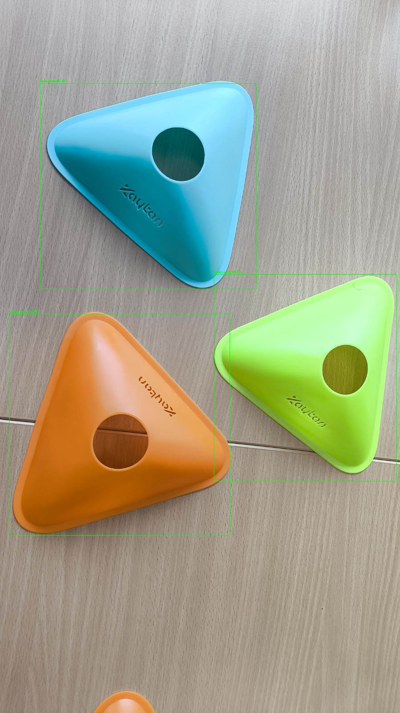
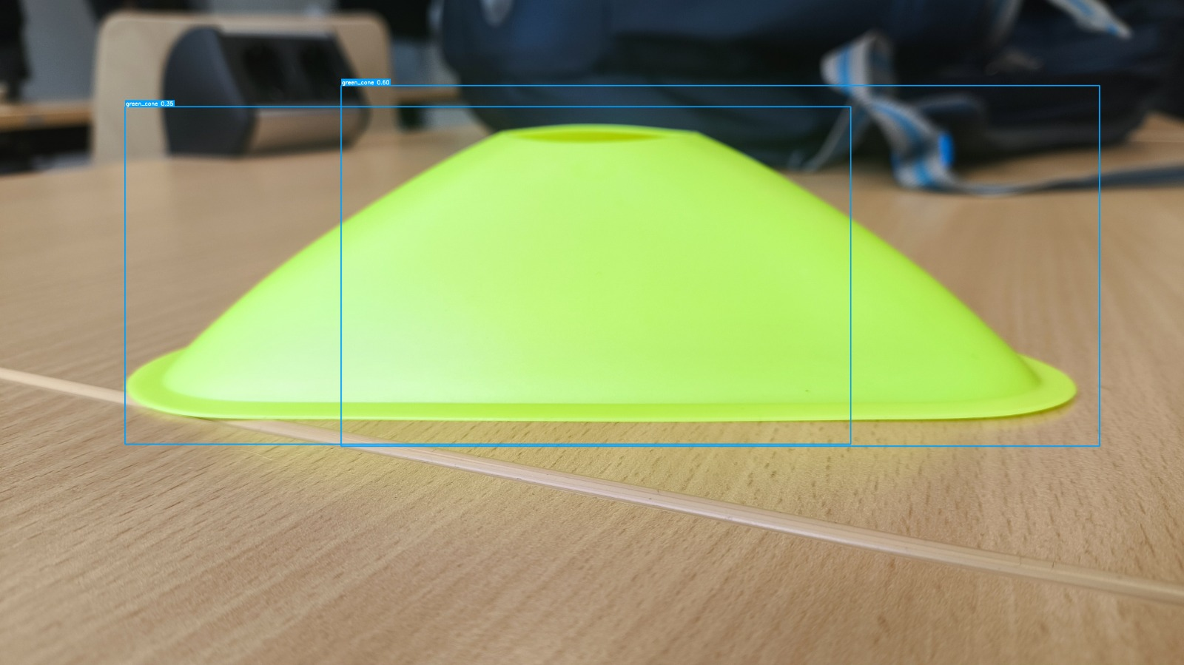
Error Modes and How we Overcame It
a cone with two overlapping bounding boxes
a scene where a corner cone is "missed“ or Not Detected
Notes:
"In conclusion, we have developed a field-ready model for robotics. By using aggressive data augmentation and the YOLOv8 architecture, we proved that you don't need thousands of images to build a high-performing system. Our model is robust against lighting changes and background noise, making it ideal for real-time autonomous navigation. Thank you, and we are now open for questions."

Slide 10
Thank you

